Slide 1
Tassels and Tummult: The Graduation Gaffe
A Tabletop Exercise

Slide 2
Funding Acknowledgement
The development of this exercise was supported by the Food and Drug Administration (FDA) of the U.S. Department of Health and Human Services (HHS) as part of a financial assistance award [FAIN] totaling $500,000 with 100 percent funded by FDA/HHS.
The contents are those of the authors and do not necessarily represent the official views of, nor an endorsement by, FDA/HHS or the U.S. Government.

Slide 3
Acknowledgements (continued)
Thank you to the volunteer subject matter experts
Kemi Oni (Iowa Department of Health)
Danny Ripley (Tennessee Department of Health)
Brad Deacon (Michigan Department of Agriculture and Rural Development)
Developed by AFDO and Food Safety Strategy, LLC

Slide 4
Safety & Logistics
Restroom
Emergency exits
Fire extinguisher, first aid, AED
Breaks and lunch plan

Slide 5
Introductions
Facilitator
Evaluators (at each table)
Icebreaker (Name, organization)

Slide 6
Purpose and Scope
At any point during production or distribution, food can be contaminated.
This scenario focuses on roles and actions that occur following a consumer illness complaint in the retail sector.
It is incumbent that relevant parties/partners understand the roles and responsibilities of all participating entities during investigations.
Communication is key to the efficiency and success of investigations.

Slide 7
Exercise Structure
Highly interactive exercise with three learning modules, each with questions and discussion:
Module 1- Identification of Potential Outbreak
Module 2 - Inspection & Sample Collection (Mock Investigation for Environmental Health Specialists)
Module 3- Conclusion

Slide 8
Materials
Situation Manual
All referred to as the SitMan
Contains more details than will be presented in each module
Module 3 and supplemental information will be provided later
Appendices
Resource list
Epidemiology of foodborne diseases
Acronym list
Personal Learning Inventory
After Action Report

Slide 9
Personal Learning Inventory (PLI)
Found at the end of the SitMan.
Designed to provide you with a document to capture questions, improvement ideas, and action items.
For your use only (not collected). You are encouraged to share your PLI with others as a record of your learning experience.
Add to your PLI throughout the day and refer to it as needed.

Slide 10
Goal of Exercise
Provides an overview of actions taken at the local, state, tribal, and territorial levels when a food-related incident occurs
Focuses on the role that key personnel play in containing the problem and protecting consumers

Slide 11
Exercise Supports
Standard 5: Foodborne Illness and Food Defense Preparedness and Response of the Voluntary National Retail Food Regulatory Program Standards reflect the current policies and procedures and is accurate as of January 2022.
If there has been an update to the procedure in your jurisdiction, please inform the group of the change and work with the facilitator to ensure all participants understand the update.
Scenario is hypothetical – don’t fight the scenario.

Slide 12
Exercise Objectives
After this exercise, you will be able to:
Discuss the sources and routes of contamination leading to the presence of pathogens in retail foodservice establishments
Assess the adequacy of control measures at retail foodservice establishments
Describe how an environmental assessment supports a foodborne illness outbreak investigation

Slide 13
Exercise Objectives (continued)
Explain the role of clinical and food laboratories, including the importance of sample collection and chain of custody
Apply local, state, tribal, and federal regulations related to outbreak investigations and pathogen control in retail establishments

Slide 14
Exercise Objectives (continued)
Utilize established investigation, reporting, and response procedures to manage the outbreak
Use a collaborative approach to efficiently deploy the responsibilities of each agency/discipline to implement proactive solutions during outbreak investigations

Slide 15
Exercise Rules of Engagement
Open, low-stress and non-public learning environment, not intended to set precedents
Listen to and respect the varying viewpoints of all the other participants
Scenario is plausible and the events occurred as presented
Suspend your disbelief, and feel free to discuss differing policies and procedures during the breakout discussions.

Slide 16
Exercise Guidelines
Commit to applying learnings from today’s activities to your job/function and sharing key learnings with colleagues
Teamwork is vital
Have fun

Slide 17
Exercise Players (Tabletops)
Roles
Environmental health specialists (EHS)
Managers
Field staff
Laboratories (LL)
Clinical
Food
Epidemiologists (LPH)
State regulatory agencies (SRA)
Rapid response team
Retail food industry (IND; optional)

Slide 18
Roles and Responsibilities
Participant: Respond to the scenario based on first-hand, experiential knowledge; current plans and procedures of individual entity, agency, or jurisdiction; and insights from training and experience.
Evaluator: Record discussion highlights at each breakout table; don’t participate but capture the dialogue for the After Action Report.
Facilitator: Lead the exercise, provide situation updates, and moderate discussions. Provide additional information and resolve questions as needed. Key officials may also assist as subject matter experts.

Slide 19
Roles and Responsibilities (continued)
Group discussion leader: Representative from each table (volunteered by the group) who leads the group.
Group recorder/reporter: Representative from each table (volunteered by the group) who ensures that the group discussions are kept on time, records the key themes discussed at the table, and is responsible for reporting out during the large group dialogue.

Slide 20
Remaining Questions / Comments
Any questions before we begin?
Expectations clear?

Slide 21
Module 1: Identification of Potential Outbreak
Presentation of Scenario - 10 min
Work Session (in breakout groups) - Answering Questions – 50 min
Module Debrief (whole group) – 60 min

Slide 22
Module 1: Identification of Potential Outbreak
June 8 : Local health department was alerted via email by a concerned parent regarding sick party guests hosted June 6.
Local epidemiologist called the parent and gathered information on who got sick, onset, symptoms, etc. The information provided met the criteria to trigger an investigation.

Slide 23
Module 1: Identification of Potential Outbreak
Epidemiologist informed their counterpart, the environmental health specialist, in case an inspection was warranted
Epidemiologist began hypothesis-generating interviews; state epidemiologist was solicited for help to expedite the process

Slide 24
Module 1: Identification of Potential Outbreak
Interviews and questionnaire answers gleaned information
1 pm
Local Grocery Store
1:20 pm
Bakery
1:40 pm
Party Ended
2 pm
5 pm
Brad's Stateline Chicken Restaurant
Host Arrived Home
6-8 pm
8:30 pm
11 pm
Cake Served
Food Consumed
Party Started

Slide 25
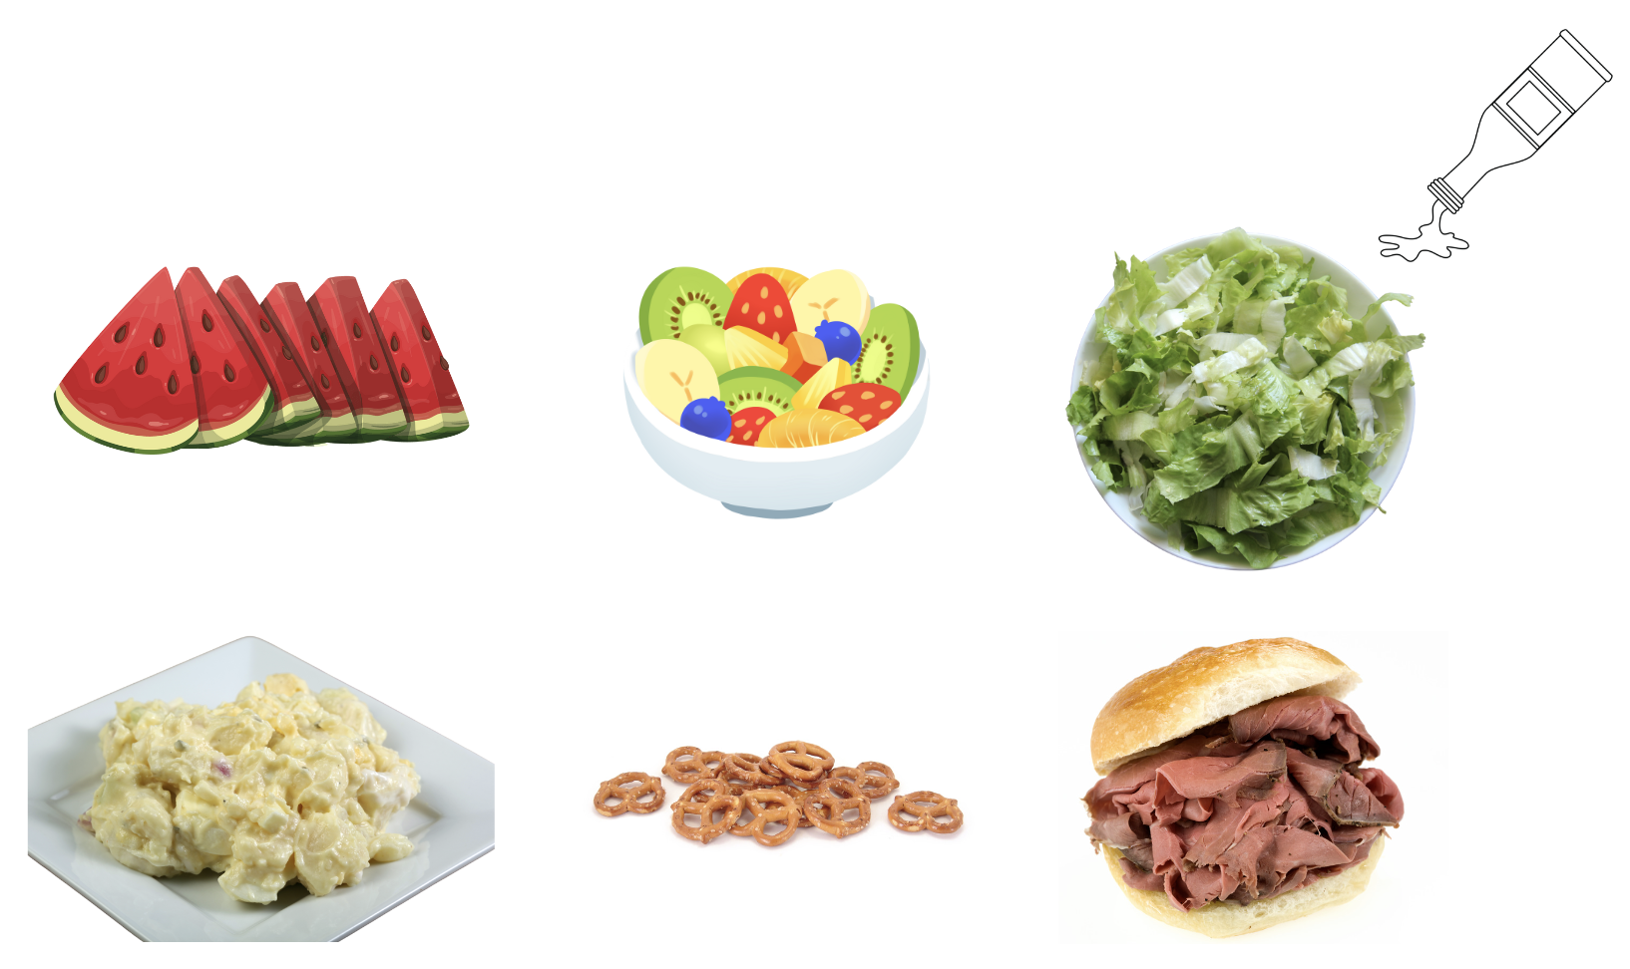
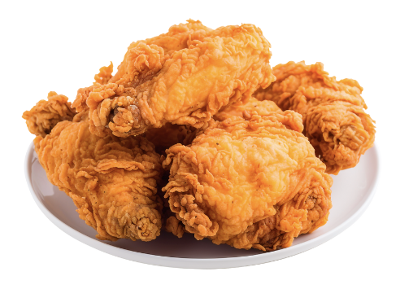
Module 1: Identification of Potential Outbreak
Grocery Store | Bakery | Brad’s Stateline Chicken Restaurant
*Leftover roast beef, fried chicken, pretzels, and potato salad

Slide 26
Module 1: Identification of Potential Outbreak
Late Friday night: Information on sick/healthy food exposures gathered
13 SICK PEOPLE | 8 HEALTHY PEOPLE
Watermelon (7) Salad (7) Dressing (6) Chicken (5) Roast beef (12) Potato salad (6) Pretzels (2) Fruit (4) Cake (9) Cookies (6) | Watermelon (5) Salad (6) Dressing (6) Chicken (6) Roast beef (4) Potato salad (4) Pretzels (1) Fruit (4) Cake (7) Cookies (4)

Slide 27
Module 1: Identification of Potential Outbreak
Late Friday: Data on 13 sick individuals obtained
Details of sick individuals including patient gender, age, disease onset, symptoms, and reported food exposures listed in SitMan

Slide 28
Module 1: Identification of Potential Outbreak
Epidemiologist and environmental health specialist discuss foods consumed by sick individuals
Epidemiologist communicates with the host about leftover food collection, the sick individuals willing to donate stool specimens (dropoff, pick-up), and the state laboratory for receiving and testing samples

Slide 29
Module 1: Identification of Potential Outbreak
Discuss hypotheses generated and likely source
Environmental health specialist alerts store of an inspection
Considers possible testing of food samples (from inspections) and sample shipment (environmental health and laboratory)

Slide 30
Summary of Timeline
Wed June 6, 1 pm: Party host picks up food, transports to home
Starting Thurs June 7, 3 am – 3 pm: Partygoers start getting sick
Afternoon, Fri June 8: Concerned parent of partygoer makes call to local health department
The epidemiologist begins investigation based on evidence
Sick and healthy people are called and surveyed by local & state epis
Environmental health prepares for possible inspections at the food establishments
Grocery store, bakery, and Brad's Stateline Chicken Restaurant are identified
Wed June 6, 5-11 pm: Guests enjoy food at the party

Slide 31
Table Activity Session
Consider the developments while answering assigned questions
EHS: Prepare questions for the mock inspection to be performed in Module 2
Identify any additional requirements, critical issues, decisions, and questions you think should be addressed at this time
Record any unanswered assigned questions or participant questions

Slide 32
Breakout Session
50 minutes to discuss questions
60 minutes for all groups to report out

Slide 33
BREAK 15 MINUTES

Slide 34
Module 2: Inspection & Sample Collection
Presentation of Scenario – 5 min
Mock Inspection – 20 min
Cont. Presentation of Scenario – 10 min
LUNCH
20-min break
40-min working lunch/ answer questions
Module Debrief (whole group) – 60 min

Slide 35
Module 2: Inspection and Sample Collection
June 9th
Food and stool collection
Leftover collection
Review prior inspection reports

Slide 36
Module 2: Inspection and Sample Collection
Summary of the previous inspection report for the GROCERY STORE
Last inspection was 10 months ago / Several "minor" deficiencies:
Non-compliance with expiration dates Presence of dented cans Two uncalibrated temperature probes Refrigerated display case operating at 46°F., exceeding the Food Code requirements

Slide 37
Module 2: Inspection and Sample Collection
Summary of the previous inspection report for the BAKERY
Last inspection was 10 months ago / Several "minor" deficiencies:
Non-compliance with expiration dates Presence of dented cans Two uncalibrated temperature probes Refrigerated display case operating at 46°F., exceeding the Food Code requirements

Slide 38
Module 2: Inspection and Sample Collection
Summary of the previous inspection report for the BRAD’S STATELINEE CHICKEN RESTAURANT
Last inspection was 10 months ago / Several "minor" deficiencies:
During the last inspection, 11 months ago, there were no notable violations

Slide 39
Module 2: Inspection and Sample Collection
Mock Inspection by EHS group (Interview the manager)
Ask questions of facilitator as you would in an inspection
20 MINUTES
ALL PARTICIPANTS OBSERVE THE EHS TABLE PERFORM THE INSPECTION

Slide 40
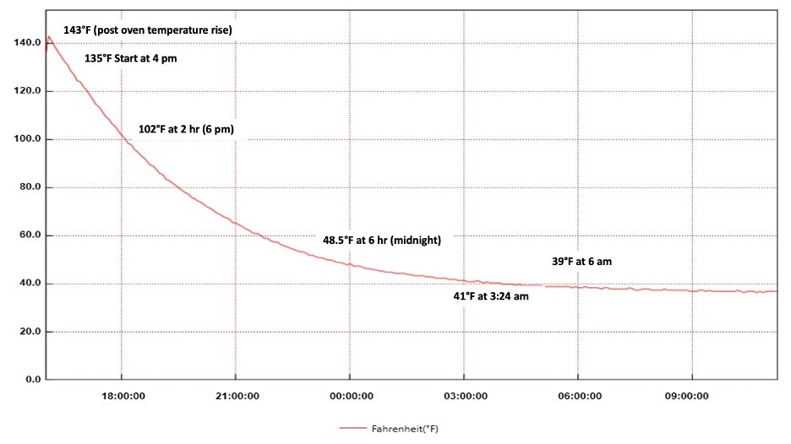
Module 2: Inspection and Sample Collection
Prime rib roasts came out of the oven (around 4 pm) and were placed in the walk-in cooler. The prime rib roasts took about 11 hours to cool to 41°F. The output from the probe is shown.

Slide 41
Module 2: Inspection and Sample Collection
Details in provided handout
Time-temperature abuse of prime rib roasts
Cooked to 143°F. over 5 hours
Cooled to 41°F. over 11 hours
Sliced cold, reheated in Alto Shaam set to 125°F.
Roast was removed from walk-in cooler at 10 a.m. with expected pickup of 11 a.m.; customer arrived at 1 p.m.
No employee illnesses

Slide 42
Module 2: Inspection and Sample Collection
On June 11th, a newspaper article, “Town Graduation Celebration Sees Dip in Attendance Amid Heatwave and Rumors” recapped the weekend:
“This year's town celebration honoring local graduates witnessed a noticeable drop in attendance, leaving organizers and attendees puzzled. Rumors circulated that a number of graduates were sidelined due to excessive partying leading up to the event or were not feeling well.”
“The scorching temperatures likely contributed to the decreased crowds, with many opting for indoor respite over outdoor festivities.”

Slide 43
Module 2: Inspection and Sample Collection
More Cases Emerge
Three individuals with similar illnesses; one visited urgent care (June 7 evening) and submitted a stool specimen
Four reports from “R U Sick” – a new initiative aimed at identifying outbreaks early on

Slide 44
Module 2: Inspection and Sample Collection
New Case Information
Three cases attended other graduation parties and one sick individual said the food consumed was catered from the local grocery store.
None of them reported consuming any food from the bakery or Brad's Stateline Chicken Restaurant.

Slide 45
Module 2: Inspection and Sample Collection
June 11, the Epidemiologist Team has calculated odds ratios (OR) from each food for the sick and case controls
Roast beef had the highest OR (12.0), P=0.048
Data on Roast Beef from Interviews / Questionnaires
 | Sick Individuals | Health Individuals
Roast Beef | 12 | 4
No Roast Beef | 1 | 4
Total | 13 | 8
*Data from R U Sick NOT included, but as noted, 2 of the 3 sick people ate roast beef sandwiches.

Slide 46
Module 2: Inspection and Sample Collection
Local epidemiologist communicates the results of the data analysis and other related findings from new cases interviews
Local environmental health specialist:
Phones the lab to prioritize testing roast beef samples
Obtains more information on roast beef/ingredients
Re-visits grocery store to discuss control measure/ follow-up

Slide 47
Summary of Timeline
Afternoon, Sat June 9: EHS reviews past inspection reports, conducts an inspection of the grocery store
Time-temperature abuse of the prime rib roasts
Newspaper article about reduced graduation turnout
More cases emerge; the epidemiologist works to interview the sick individuals
Monday, June 11: Odds ratio (with significant P-value) reported for roast beef
EHS calls grocery store to obtain more information on roast beef (prime beef roasts) and potential re-visit
Laboratory prioritizes testing roast beef samples
Morning, Sat June 9: Leftovers collected by EHS and sent to laboratory
Results and new case information communicated to EHS

Slide 48
Table Activity Session
Consider the developments while answering assigned questions.
Identify any additional requirements, critical issues, decisions, and questions you think should be addressed at this time.
Record any unanswered assigned questions or participant questions.

Slide 49
Lunch – 20 Minute Break 40 Minute Table Discussion

Slide 50
Breakout Session
60 minutes for all groups to report out

Slide 51
Module 3: Conclusions
Presentation of Scenario – 10 min
Work Session (in NEW breakout groups): Answering Questions – 30 min
Module Debrief (whole group) – 30 min

Slide 52
Module 3: Conclusions
Stool sample lab results received: Enterotoxin detected in stool specimens from the first reported cases, toxin produced by C. perfringens
By Friday, June 15, food lab results received: Roast beef samples from the party host’s home and grocery store inspection were confirmed positive for C. perfringens by culture.
All other food from the party host’s home was negative.

Slide 53
Module 3: Conclusions
Inspectional findings + lab results = outbreak was due to contaminated roast beef
Beef rib roasts at the grocery store improperly cooked, cooled, and reheated for a duration that allowed the pathogen to grow
The grocery store also supplied the same roast beef to other parties that were associated with the “R U Sick” patients

Slide 54
Module 3: Conclusions
Other factors that contributed to the outbreak:
New deli manager/lack of taking routine temperatures, unlike the former deli manager
High staff turnover
Temperature probes not functioning properly

Slide 55
Module 3: Conclusions
Other considerations that likely contributed to the outbreak – Party Host (Home Consumer)
No temperature control in the party host's car
The party host left the roast beef/food out on the table without any temperature control
All factors may have contributed to C. perfringens reaching higher numbers (e.g., consumer temperature-abused product resulting in more illnesses)

Slide 56
Module 3: Conclusions
Local environmental health specialist followed up with the grocery store about what went wrong and opportunities for prevention:
Training
Store's risk control plan includes taking and recording temperatures for cooking, cooling, and reheating, reviewing by a certified food protection manager (CFPM) daily, and sending to the health department weekly

Slide 57
Module 3: Conclusions
Stool specimens tested positive for enterotoxin
C. perfringens detected in roast beef samples by culture from leftovers and grocery store
Time-temperature abuse occurred at grocery store
Party host also transported food and left food out at home without temperature control
Plan developed to correct violations at the grocery store

Slide 58
Table Activity Session
Change groups! Count off by the number of tables.
Consider the events/timeline while answering assigned questions.
Identify any additional requirements, critical issues, decisions, and questions you think should be addressed at this time.
Record any unanswered assigned questions or participant questions.

Slide 59
Breakout Session
30 minutes to discuss questions
30 minutes for all groups to report out

Slide 60
Exercise Objectives
Recapping learning objectives:
Discuss the sources and routes of contamination leading to the presence of pathogens in retail foodservice establishments.
Assess the adequacy of control measures at retail foodservice establishments.

Slide 61
Exercise Objectives (continued)
Describe how an environmental assessment supports a foodborne illness outbreak investigation.
Explain the role of clinical and food laboratories, including the importance of sample collection and chain of custody.
Apply local, state, tribal, and federal regulations related to outbreak investigations and pathogen control in retail establishments.

Slide 62
Exercise Objectives (continued)
Utilize established investigation, reporting, and response procedures to manage the outbreak.
Use a collaborative approach to efficiently deploy the responsibilities of each agency/discipline to implement proactive solutions during outbreak investigations.

Slide 63
Evaluation
https://www.surveymonkey.com/r/RQSJPMM

Slide 64
Other Activities
After Action Report and Improvement Plan (AAR/IP)
Will be generated
Your feedback from wrap-up questions will be incorporated
Consider this For Official Use Only and share only with those with a need to know
Review your PLI and add final thoughts (do not turn in; PLI stays with you)

Slide 65
Resources
Complete list in SitMan – your situation manual
FDA Model Food Code: https://www.fda.gov/food/fda-food-code/food-code-2022
EpiReady: https://www.neha.org/epi-ready
CIFOR CDC landing page: https://www.cdc.gov/ncezid/dfwed/food-safety-office/cifor.html
RRT Best Practices Manual: https://cifor.us/downloads/clearinghouse/2017-RRT-Best-Practices-Manual_FINAL_191216_082235.pdf
Integrated Food Safety Centers of Excellence (Food Safety CoEs) : https://www.cdc.gov/foodsafety/centers/index.html ; Products developed by CoEs: https://foodsafetycoe.org/

Slide 66
Thank you and Questions

