Slide 1

2020 AFDO-Managed
Retail Program Standards
Grant Program
Overview Presentation
Fall 2019
http://afdo.org/retailstandards
Notes:
Key Messages
(Slides 2,3,5)
(Slide 4)

Slide 2
Success of the FDA AFDO-Managed Program
The program works well and ensures standards are met because of the carefully crafted rules for each subaward category, determined and honed by the FDA Joint Advisory Group (JAG) in the program’s first 4 years
AFDO can take some of the credit for a well-executed and well-run program, but the program’s success is a direct result of FDA’s careful design for each subaward type

Slide 3
Since 2014 AFDO Has Managed...
2,515 | Applications
1,985 | Awards
33-100% | Award Rate
$8,196,799 | Awarded
  Totals for the AFDO-Managed Retail Program Standards Grant Program
Notes:
AFDO and FDA have created a simple system, awarding a significant amount of funding to SLTTs

Slide 4
Since 2014 Funded Jurisdictions Have Achieved...
324 | Self-Assessments
736 | Standards Met
535 | Standards Audited
43 | Risk Factor Studies
3,324 | Retail Personnel Trained
The top-progressing 50% of subawardees, a total of 254 unique jurisdictions, have met 2.6 individual Standards and completed 2.1 Verification Audits (on average)
Notes:
YOU ALL have used it to achieve a tremendous number of important Retail Program Standards Goals

Slide 5
6-Year Reach of the Program (CY 2014-2019)
Number of Unique Jurisdictions Funded
1
FDA Project Officer
Management Provided by AFDO
507
Unique Jurisdictions Funded
Notes:
This program is for you - SLTTs

Slide 6
Annual Reach of the Program (CY 2019)
Number of Unique Jurisdictions Funded
as many as
296
jurisdictions funded
In a single year
Notes:
This program is for you - SLTTs

Slide 7
Annual Reach of the Program (CY 2019)
Number of Unique Jurisdictions Funded
as many as
296
jurisdictions funded
Local jurisdictions
90%
8%
States
In a single year
1%
Tribes
1%
Territories
Notes:
This program is for you - SLTTs

Slide 8
80% of Subawardees Show Progress Through the Standards (or are new to this grant program)
66%
Meeting & Auditing Standards
Avg of 2.2 Standards met and 1.6 Verification Audits completed.
109
13%
New grantees seeking training and Self-Assessments
Often gateway subawards
64
334
507 Total Jurisdictions Funded

Slide 9
Room for Improvement:
21% of Subawardees Have Not Shown Progress
11%
Active
Not showing progress through the Standards
10%
Have not shown progress
No longer active (no requests in past 3 grant cycles)
52
57
507 Total Jurisdictions Funded

Slide 10
Calendar Year 2019 Subawards
Grant Category | Number of Awards | Funding
Category 1 Fixed Projects (Self-Assessments, Verification Audits) | 110 | $282,500
Category 1 Custom Projects | 60 | $165,897
Category 2 Moderate Projects | 32 | $568,549
Category 3 Training Projects | 242 | $677,492
Category 4 Food Protection Task Force Projects | 20 | $49,647
Calendar Year 2019 Totals | 464 | $1,744,085
Notes:
Last year 464 awards were made. For CY 2020 we have approximately $2,000,000 available for these subawards. We expect to be able to give make roughly twice the number of Category 2 subawards.

Slide 11
CY 2019 ROI by Outcome
CY 2019 Subawards ROI Summary by Outcome | Jurisdictions or Personnel Supported | Average Cost | FDA Investment
Self-Assessments | 60 | $2,500 | $150,000
Standards Completed and Audited | 132 | $1,986 | $262,000
Personnel Trained (Retail Courses, Local Training, FDA Seminars) | 1,120 | $684 | $766,000
Personnel Support Provided | 32 | $5,488 | $176,000
Infrastructure Support Provided | 70 | $5,571 | $390,000
Calendar Year 2019 Totals |  | $5,912 | $1,744,000
Notes:
FDA is wanting to see measurable outcomes. Keep that in mind when planning your applications.

Slide 12
Grantee Comments About the Program
“The VNRFRPS Grant has greatly aided LLCHD to advance the Retail Standards work being done by the department. These grants are easy to apply for and easy to report on, allowing us to do more work without excessive administrative burden.”
- Lincoln Lancaster County Health Department
“The grant format funded by the FDA and administered by AFDO has by far been the simplest grant application to date. I would highly recommend state and local food safety programs consider applying for these grants. The amount of money dedicated from the FDA to help state and local programs conform to the VNRFRPS is greatly appreciated.”
- Kansas Department of Agriculture
“The customer support provided through AFDO and the ease of the application and reporting process were outstanding.”
- Colorado Department of Public Health and Environment
Notes:
AFDO and FDA have created a very simple, user-friendly system

Slide 13
Calendar Year 2020 Application Period
The application portal will be open to accept submissions for the CY 2020 funding year from September 4, 2019 through October 15, 2019 at 7:59 PM Eastern Time.

Slide 14
Retail Funding Categories
Category
1
Category
2
Category
3
Category
4
Small Projects
Up to
$3,000
Moderate Projects
Up to $20,000
Training Projects
Up to
$3,000
Food Protection Task Force
Up to
$3,000
Notes:
Category 1: The goal for this category is to provide funding for jurisdictions to complete a Self-Assessment of all nine Standards, small projects related to meeting one or more Standards, verification audit(s) confirming the results of the jurisdiction’s Self-Assessment (indicating that it meets one or more of the Standards), or custom projects that increase a jurisdiction’s conformance with the Standards. Category 2:Projects in this category should aim for completion of more ambitious projects that help further conformance with the Retail Program Standards (computer software systems, risk factor studies, development of a written compliance program, training events, etc.). Applicants for this category must have conducted a Self-Assessment within the last five years. Category 3: The goal of this category is to provide funding for jurisdictions to send staff to training to meet the requirements of Standard 2 (Step 1 & 3 Curriculum or CEU maintenance) or to attend FDA Regional Seminars to maintain FDA Standardization. Category 4: The goal of this category is to advance conformance with the Retail Program Standards by supporting standing Food Protection Task Force activities (or similar Food Advisory Board/Council activities, whether Task Force/Board/Council is supported by an FDA grant or not). Allowed activities under this category include planning costs and/or travel funds for meetings, sponsored trainings, workshops, tabletop exercises and mentorship activities. Successful applications will clearly explain how the proposed project helps the jurisdiction meet the requirements of Standard 5 Foodborne Illness and Food Defense Preparedness and Response and/or Standard 7 Industry and Community Relations.

Slide 15
Category 1 Detail
Category
1
Category
2
Category
3
Category
4
Moderate Projects
Up to $20,000
Training Projects
Up to
$3,000
Food Protection Task Force
Up to
$3,000
Small Projects
Up to
$3,000
Verification Audit of One Standard
$2,000
Verification Audit of Two or More Standards
$3,000
Self Assessment of All Nine Standards
$2,500
Custom Small Project
Up to $3,000
Notes:
Fixed-reimbursement grants are associated with most Category 1 Small Projects. If awarded, upon completion of the project and approval of the Final Report, a specific dollar amount will be reimbursed to the grantee’s agency or organization. For these specific grant types only, applicants do not need to submit a budget or budget justification, as individual expenses are not reported. Reimbursement will be made on a fixed-reimbursement basis upon submission of a completed final report and FDA Form 3958.

Slide 16
Application Priorities – Category 1 Subawards
Complete/Update a Self-Assessment of all Nine Standards once every five years (Self-Assessment Subawards)
Meet and complete Verification Audits for each of the nine Standards (Fixed Amount Subawards)
Projects that increase your Retail inspectional capability, preparing you to meet additional Standards (Custom Project Subawards)
Notes:
AFDO and FDA have created a simple system, awarding a significant amount of funding to SLTTs

Slide 17
Application Priorities – Category 2 Subawards
Meet more complex and resource intensive needs that lead to meeting and auditing Standards using Category 2 Moderate Projects, including the following CY 2020 prioritized projects:
  Risk Factor Baseline Study or equivalent public health measure with a written summary of the data analysis, or evaluation of inspection data with written summary of data analysis.
  Development and implementation of an intervention strategy that is based on a completed Risk Factor Study or equivalent public health measure.
  Projects that lead to completion of Standard 9 (including submission of a Verification Audit).
Notes:
AFDO and FDA have created a simple system, awarding a significant amount of funding to SLTTs

Slide 18
Application Priorities – Category 3 Subawards
Utilize Category 3 Training Subawards to meet and maintain compliance with Standard 2.
  Program Fact: 1,032 individuals have been (or will be) trained this year, at an average cost of $684 per person, supported by CY 2019 Category 3 Training Subawards. 731 (71%) of the personnel supported will attend FDA Seminars, FDA Retail Training Courses, or HACCP for Retail training.
Notes:
AFDO and FDA have created a simple system, awarding a significant amount of funding to SLTTs

Slide 19
Application Priorities – Category 4 Subawards
Utilize Category 4 Food Protection Task Force Projects to meet and maintain compliance with Standards 5 and/or 7.
  Program Fact: Category 4 funding is intended to support the involvement of local, tribal and territorial jurisdictions in the activities of existing state or territorial Food Protection Task forces (a link to approved task forces will be added to the AFDO Retail website before the portal opens on September 4). Applications outside this specific purpose will not be funded through this subaward category.
Notes:
AFDO and FDA have created a simple system, awarding a significant amount of funding to SLTTs

Slide 20
Additional Retail Funding Opportunities
To assure progress in meeting all nine of the Retail Program Standards, consider utilizing the other two FDA-funded Retail Grant Programs as your needs change and your knowledge of the Standards grows:
  FDA-Managed Retail Program Standards Cooperative Agreement Program: Provides funding to advance conformance of the Retail Program Standards and can include work on multiple standards and projects over a three to five-year period. Not currently accepting new applications.
  NACCHO-Managed Retail Program Standards Mentorship Program: The mentorship program provides peer-to-peer assistance and intensive technical support to guide and assist mentee local health department (LHD) programs in the necessary steps that have proven to efficiently and effectively bring an enrolled program into full conformance with the individual Standards. Currently accepting applications through October 12, 2019.
Notes:
AFDO and FDA have created a simple system, awarding a significant amount of funding to SLTTs

Slide 21
NACCHO-Managed Mentorship Program
September 4th Application Period
$15,000 up to $24,000 for Mentees and Mentors is available
Application portal is open until October 12
Additional info and application information: https://www.naccho.org
Notes:
AFDO and FDA have created a simple system, awarding a significant amount of funding to SLTTs

Slide 22
NACCHO-Managed Mentorship Program Goals
Establish a growing network of retail food regulatory programs experienced in the implementation of the Retail Program Standards.
Improve NACCHO and FDA’s understanding of the technical assistance needs of retail food regulatory programs around the Retail Program Standards.
Identify strategies to enhance implementation of the Retail Program Standards among retail food regulatory programs.
Provide a venue for enrolled jurisdictions to share resources, experiences, and lessons.
Strengthen relationships between retail food regulatory programs and FDA.
Notes:
AFDO and FDA have created a simple system, awarding a significant amount of funding to SLTTs

Slide 23
CY2020 Tips for Applicants!
Communicate with your Retail Specialist. They are fantastic resources and can help you decide where best to focus your efforts as you advance through the Retail Program Standards.
Clearly convey how your project will meet Standards and advance conformance. Assure your application lists specific and measurable outcomes that will allow you to progress toward meeting all 9 Standards.
For Category 2... focus on completing a Risk Factor study, implementing Intervention Strategies, or meeting Standard 9. These projects are of special interest to FDA.
Ensure your budget worksheet is clear and well-itemized and matches the requested funding amount. Be sure to review the allowable and non-allowable cost section of the 2020 Grant Guidance.
Notes:
AFDO and FDA have created a simple system, awarding a significant amount of funding to SLTTs

Slide 24
CY2020 Tips for Applicants! (continued)
Sharpen those pencils! How can you achieve the greatest progress at the most efficient cost? Remember, this is a competitive grant program.
Utilize the tools on the website http://afdo.org/retailstandards including the CY 2020 Grant Guidance and the Project Ideas page.
See us during a break. We want to help you succeed with your application and will make every effort to deliver outstanding support.
Discover what other jurisdictions are doing. See the Retail Standards Interactive Map during a break or online at http://afdo.org/retailstandards
Call or email us anytime! 850-583-4593 or retailstandards@afdo.org
Complete your application before the deadline. The portal closes on October 15, 2019 at 7:59 PM Eastern Time.
Notes:
AFDO and FDA have created a simple system, awarding a significant amount of funding to SLTTs

Slide 25
Reimbursement Tips for Current Grantees
Are you ready to submit your Final Report for reimbursement? Here are a few reminders for a quick and smooth reimbursement process:
  The Reimbursement Form (required in Years 1-4 of the program) is no longer required!
  For Category 1 Custom projects, Category 2 , Category 3 and Category 4 projects: include documentation for all claimed expenses―with the exception of per diem if the GSA rate is being claimed. (Fixed Category 1 grants do not require expense documentation.)
  If a Self-Assessment or Verification Audit(s) were completed as a part of your project, Form FDA 3958 is required.
  Ensure changes to the budget or scope of your project have been approved before submitting for reimbursement. Change requests should be submitted via email to retailstandards@afdo.org.
Notes:
AFDO and FDA have created a simple system, awarding a significant amount of funding to SLTTs

Slide 26
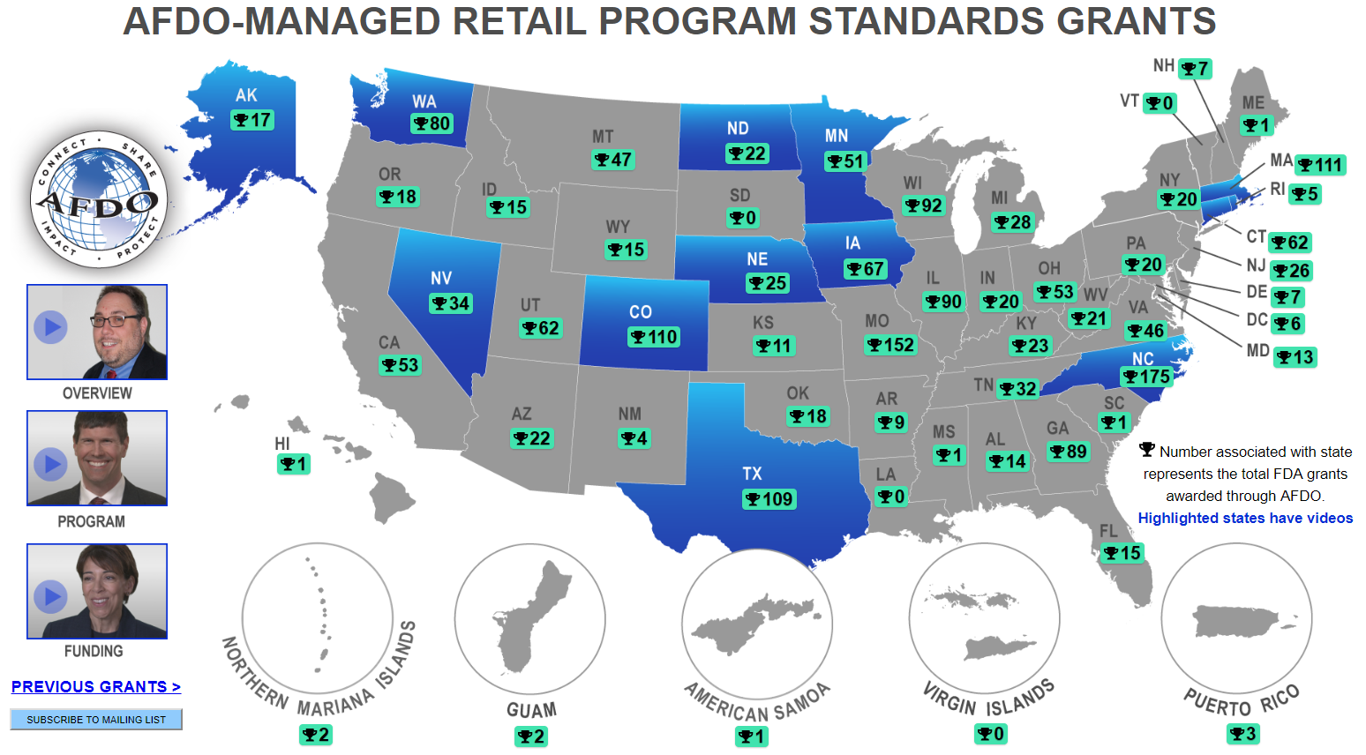
Retail Standards Interactive Map
Notes:
AFDO and FDA have created a simple system, awarding a significant amount of funding to SLTTs

Slide 27
Retail Standards Interactive Map

Notes:
AFDO and FDA have created a simple system, awarding a significant amount of funding to SLTTs

Slide 28
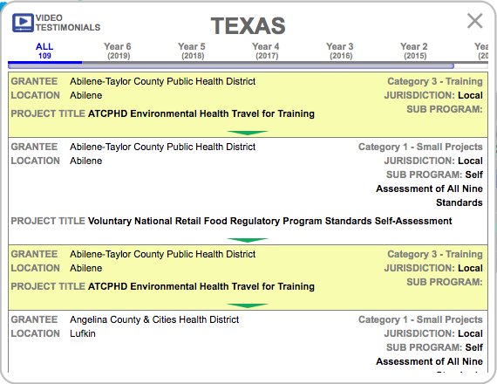
Retail Standards Interactive Map
Notes:
AFDO and FDA have created a simple system, awarding a significant amount of funding to SLTTs

Slide 29
Retail Standards Interactive Map

Notes:
AFDO and FDA have created a simple system, awarding a significant amount of funding to SLTTs

Slide 30
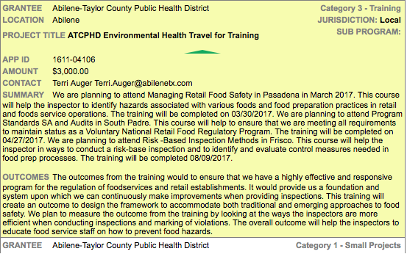
Retail Standards Interactive Map
Notes:
AFDO and FDA have created a simple system, awarding a significant amount of funding to SLTTs

Slide 31
Retail Standards Interactive Map

Notes:
AFDO and FDA have created a simple system, awarding a significant amount of funding to SLTTs

Slide 32
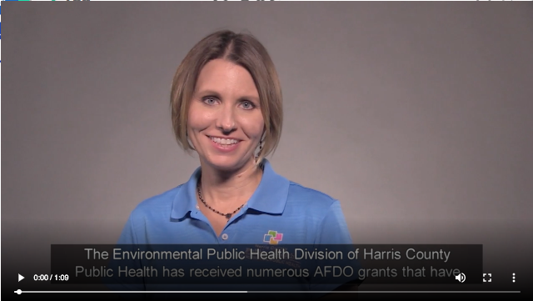
Retail Standards Interactive Map
Notes:
AFDO and FDA have created a simple system, awarding a significant amount of funding to SLTTs

Slide 33
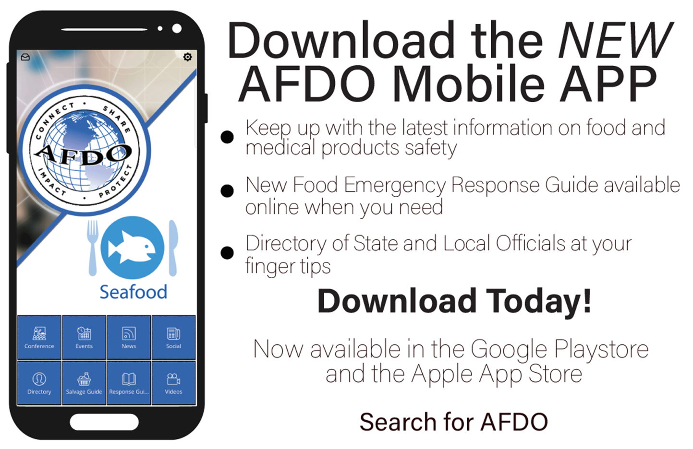
Resources: AFDO Mobile App
Notes:
AFDO and FDA have created a simple system, awarding a significant amount of funding to SLTTs

Slide 34
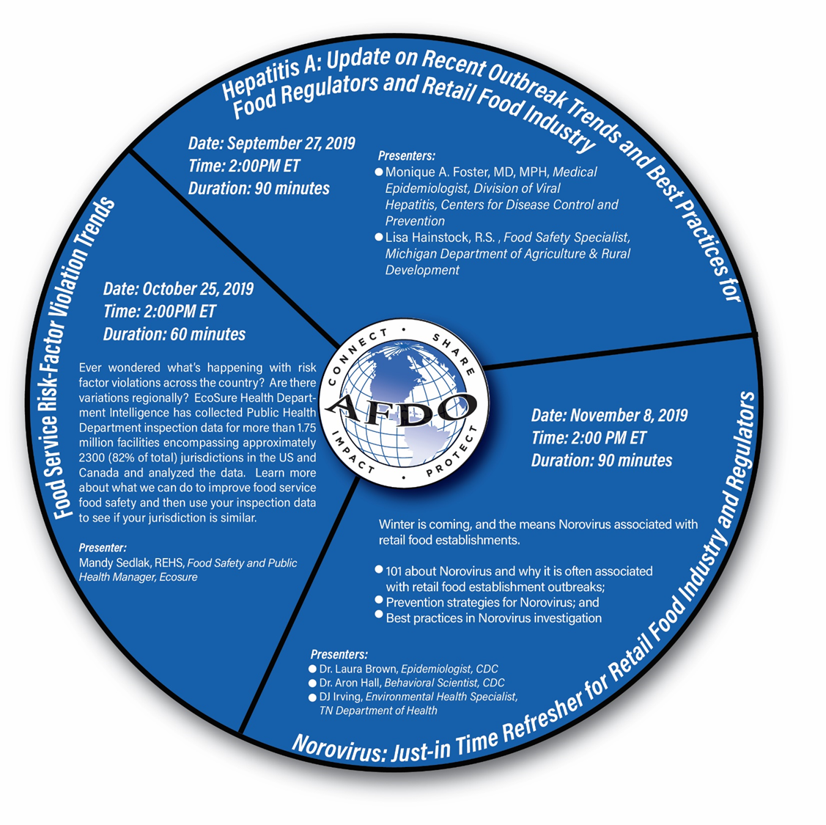
Resources: AFDO Retail Webinar Series
Register
http://afdo.org/retail/webinars
Questions?
717-757-2888
afdo@afdo.org
Notes:
AFDO and FDA have created a simple system, awarding a significant amount of funding to SLTTs

Slide 35
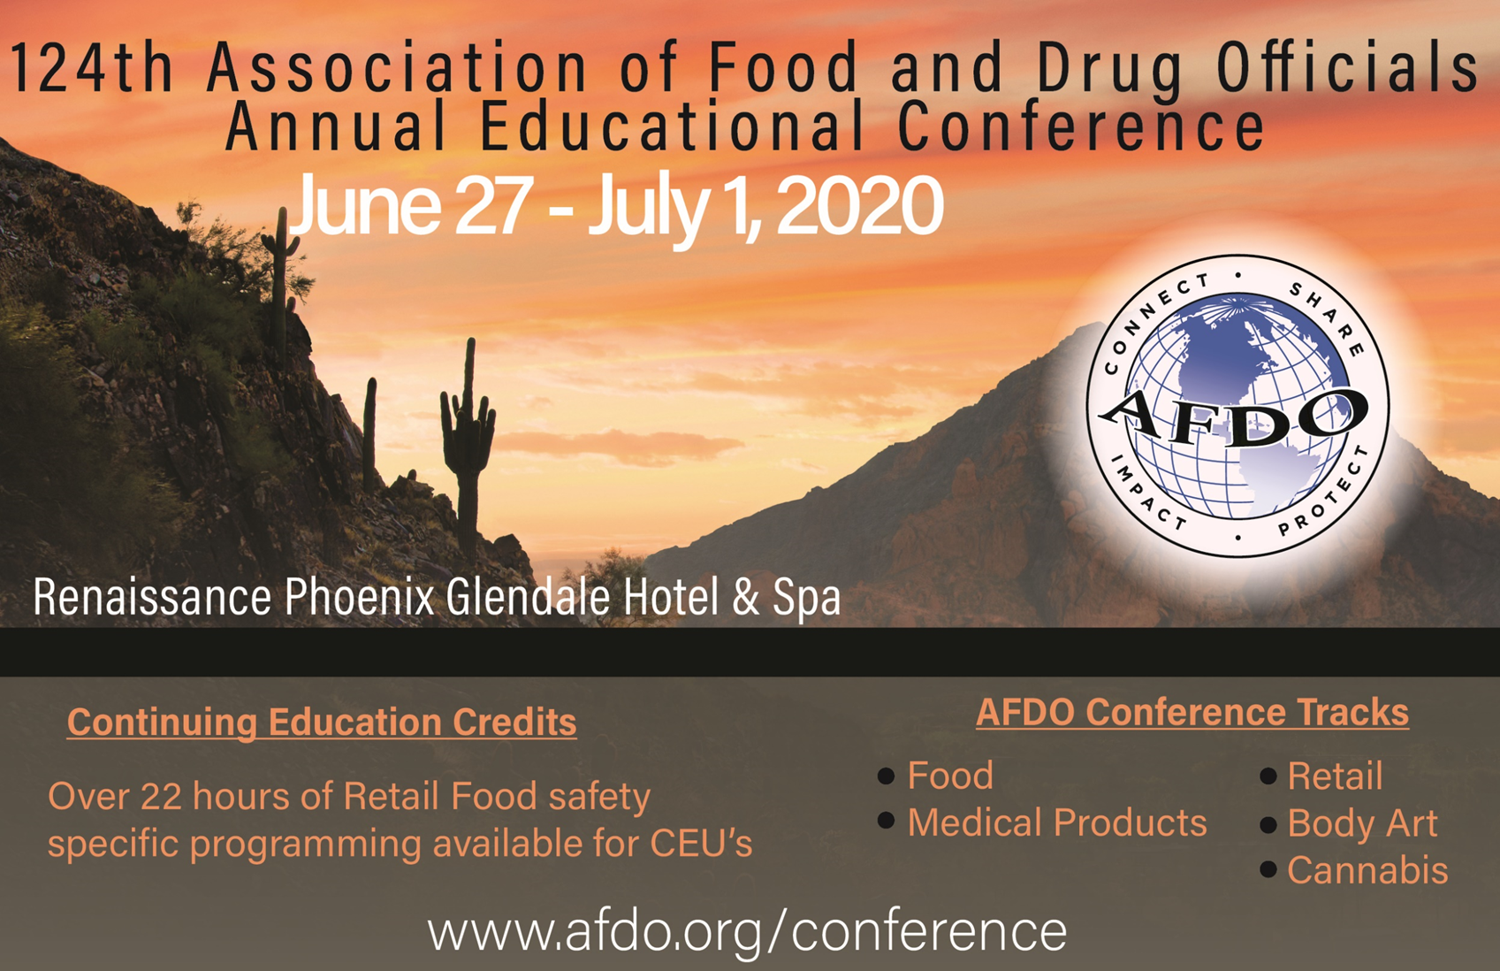
124th AFDO Annual Education Conference
Notes:
AFDO and FDA have created a simple system, awarding a significant amount of funding to SLTTs

Slide 36
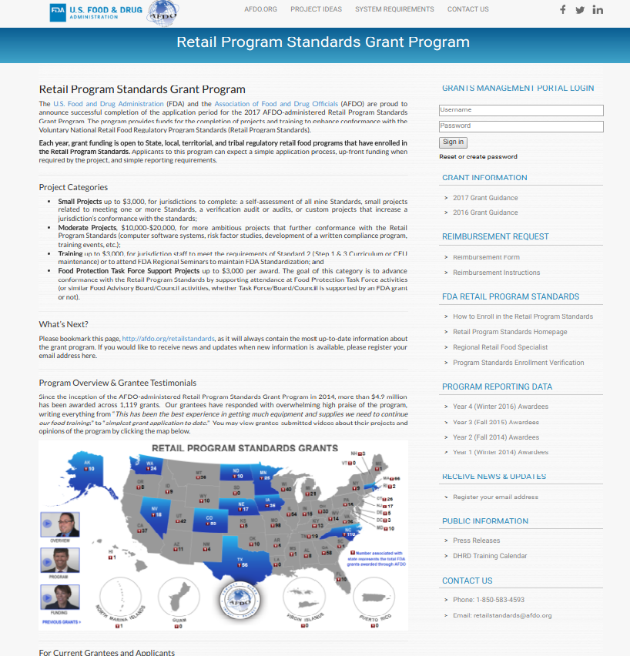
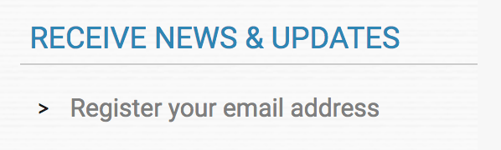
Contact Us
Email: retailstandards@afdo.org
Phone: 850-583-4593
Retail Standards
Program Information
http://afdo.org/retailstandards

Slide 37
2020 AFDO-Managed
Retail Program Standards
Grant Program
Overview Presentation
Fall 2019
http://afdo.org/retailstandards
Notes:
Key Messages
(Slides 2,3,5)
(Slide 4)

