Slide 1
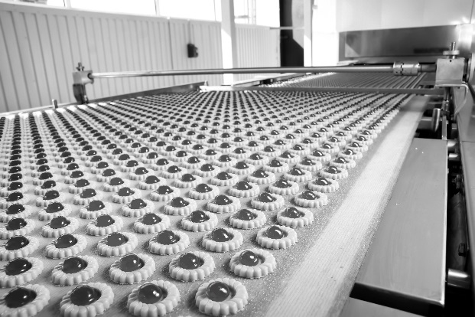
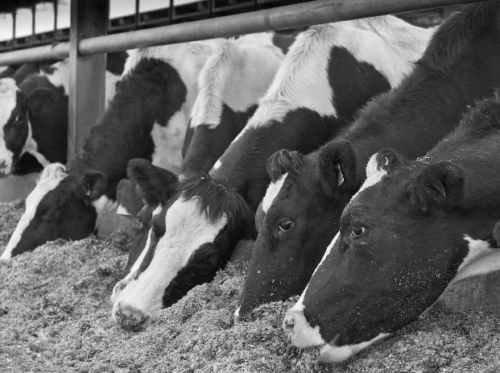
ifpti.org
State Human and Animal Food Laboratory Curriculum Framework
Notes:
Slide 1: “Copy and Paste Slide Title Here”

Slide 2
Laboratory Framework
5-Year project involving
APHL
AFDO
AAFCO
FDA OTED (formerly DHRD)
IFPTI
Goal: a Competency-Based Curriculum Framework for State Human and Animal Food Laboratory Professionals

Slide 3
Lab Framework (Current Version)

Slide 4
Framework Development Work Group
FDA / USDA | State | State | APHL | AFDO | AAFCO
Dan Rice | Patty Lucas (FL) | Steve Sobek (former WI) | Cathy Johnson | Yvonne Salfinger | Nancy Thiex
Holly Rhodes | Maria Ishida (NY) | Dirk Shoemaker (former NE) | Robyn Randolph | Ron Klein
Paul Morin | Kathleen Wickman (OR) | Reginald Blackwell (DC) | OTED (formerly DHRD) | Karna | CFIA
Cassandra Kontas | Tom Phillips (MD) | Dana Shell (GA) | Will Bet-Sayad | Anthony Barbagallo | Neil Vary
Richelle Richter | Gale Hagood (MS) | Susan Murphy (VA) |  |  | Deb Moir
Charles Pixley |  |  |  |  | Corinne Pequignot

Slide 5
Project Status
All competencies and performance indicators built out for the Entry Core Content Areas
Course Design Documents delivered to APHL

Slide 6
Project Status
Competency development for Entry Level Program-Specific Content Areas started May 2017

Slide 7
Future Steps
Build out narrow competencies and performance indicators for Chemistry and Microbiology Program Areas (Entry Level)
Create Course Design Documents (blueprints) for Chemistry and Microbiology Program Areas (Entry Level)
Advance upward on the Framework (Mid Level)

Slide 8
Journal of AOAC International
“Developing a Competency Framework for U.S. State Food and Feed Testing Laboratory Personnel”
Volume 97, No. 3, 2014

Slide 9
Questions?
Christopher Weiss, IFPTI
chris.weiss@ifpti.org

